Slide 1
AI Power (Suzhou) Tech Co., Ltd

Slide 2
Domestic project
Domestic project
01
Microgrid Cluster
&Virtual Power Plant
02
Integrated Energy System
(PV-ESS-DG-Heating)
03
Zero Carbon Park Project
(PV-ESS-Charging)
04
Microgrid Laboratory
(AC/DC System)

Slide 3
01
Microgrid Cluster
&Virtual Power Plant
Integrated Energy System
(PV-ESS-DG-Heating)
02
(1) Xiong'an Baiyangdian Microgrid Cluster (Wind, PV, ESS, charging and airheat)
(2) Xibaipo village level virtual power plant demonstration (grid connection)
(3) Hebei Pingshan Yingli Virtual Power Station
(4) Synchronized frequency and voltage control technology and cluster dispatching and evaluation system
(1) Xinjiang 703 Institute Madong Oilfield PV-ESS-DG Project
(2) New Island Power System in Dongtou, Zhejiang Province
(3) Yunnan Dehong PV-ESS Integrated Energy System
(4) Xinjiang Military Civilian Integration PV-ESS-DG Project
(5) Yunnan Modularization Flexible Power Supply System Project
(6) PV-ESS-DG integrated Container
(7) Guangdong Shaoguan Hydropower Project
(8) Yunnan Dali New Rural Distributed PV-ESS Project
(9) FuJian military Microgrid
(10) Hebei Handan hydropower-PV-ESS microgrid
(1) Lianyungang PV-ESS-Charging Smart Park
(2) Tianjin Zero Energy Cabin
(3) Zhenjiang PV-ESS-Charging Smart Park Project (Grid connected)
(4) Inner Mongolia PV-ESS-Charging Smart Park
(5) Guangdong Foshan PV-ESS-Charging Low Carbon Park
(6) CRRC Smart Valley Zero Carbon Park Project
(7) Nanjing WIND-PV-ESS Smart Park Project
(8) Northeast Electric Power University Low Carbon Park Project
(9) V2G demonstration station control management platform project
(10) Henan digital twin microgrid project
(1) Shanghai Electric Power University Microgrid Laboratory
(2) Hunan CRRC AC/DC Microgrid Laboratory
(3) Hubei Electric Power Academy Microgrid Laboratory
(4) National University of Defense Technology Micronet Laboratory
(5) North China Electric Power University Microgrid Laboratory
03
Zero Carbon Park Project
(PV-ESS-Charging)
Microgrid Laboratory
(AC/DC System)
04

Slide 4
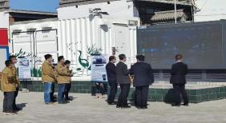
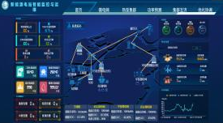
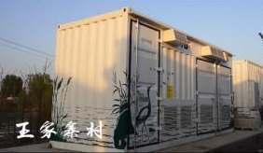
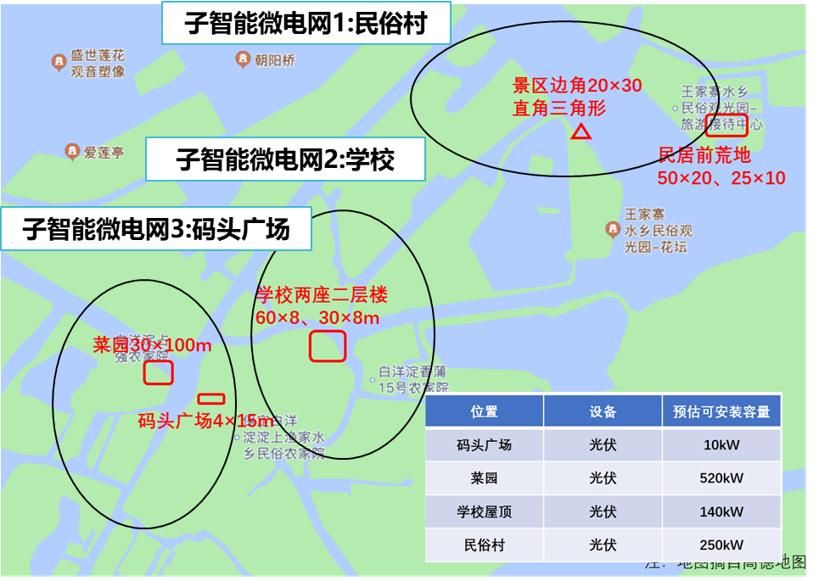
Xiong'an Baiyangdian Microgrid Cluster (Wind, PV, ESS, Charging and Airheat)
01
Microgrid Cluster
&Virtual Power Plant
02
Integrated Energy System
(PV-ESS-DG-Heating)
03
Zero Carbon Park Project
(PV-ESS-Charging)
04
Microgrid Laboratory
(AC/DC System)
Model project awarded by National Energy Commission
Location&Commissioning
Place: Xiong'an, Hebei Time of putting into operation: March 2022
Installed Capacity
PV system: 1.1MW Wind turbine: 4kW
Energy storage system: 11MWh Air source heat pump: 1338 households
Advantages and Characteristics
Combined with regional distribution, AI Power technical team built sub smart grid projects in folk village, school and dock square respectively, innovatively used nested micro grid clusters, improved regional power supply capacity, improved power quality, and made breakthroughs in seamless switching of 10kV parallel and off grid and mutual aid of microgrid clusters.

Slide 5
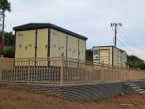
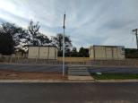
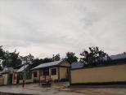
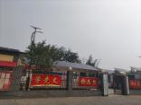
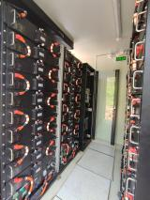
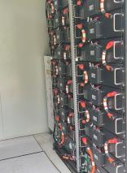
01
Microgrid Cluster
&Virtual Power Plant
02
Integrated Energy System
(PV-ESS-DG-Heating)
03
Zero Carbon Park Project
(PV-ESS-Charging)
04
Microgrid Laboratory
(AC/DC System)
Xibaipo Village Level Virtual Power Plant Demonstration (Grid connection)
Model project awarded by National Energy Commission
Location&Commissioning
Place: Xibaipo, Hebei Time of putting into operation: October 2021
Installed Capacity
PV system: 800kW Energy storage system: 600kW/1200kWh
Advantages and characteristics
Advantages and characteristics
Advantages and Characteristics
It has achieved convenient and friendly access to green energy at the power supply side, zero energy consumption operation mode at the pilot village level, digital transformation at the power grid side and multi-level integrated development of source, grid, load and storage at the consumer side, improved the income of people in the old area and electricity experience, and helped rural revitalization and carbon neutral development.

Slide 6
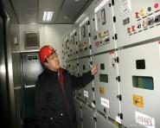
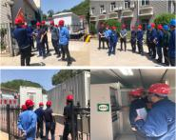
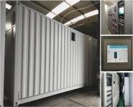
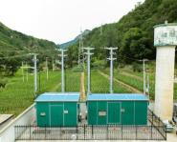
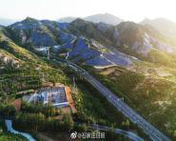
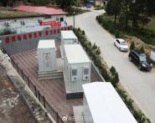
01
Microgrid Cluster
&Virtual Power Plant
02
Integrated Energy System
(PV-ESS-DG-Heating)
03
Zero Carbon Park Project
(PV-ESS-Charging)
04
Microgrid Laboratory
(AC/DC System)
Hebei Pingshan Yingli Virtual Power Station
Model project awarded by National Energy Commission
Location&Commissioning
Place: Yingli, Pingshan, Hebei Time of putting into operation: July 2020
Installed Capacity
Distributed PV system: 1.2MW Energy storage system: 1MW/2.1MWh
Advantages and characteristics
Advantages and Characteristics
AI Power team has realized a 20% increase in PV absorption capacity in the region by using microgrid cluster control system, grid inverter, energy storage system integration, edge collector, etc.The power quality of the line is improved, the distributed photovoltaic voltage out of limit problem is effectively solved, and the power supply reliability at the end of the grid is improved.

Slide 7
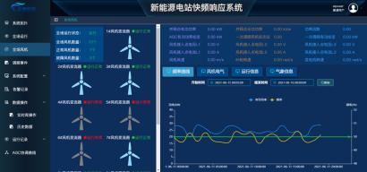
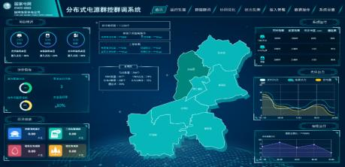
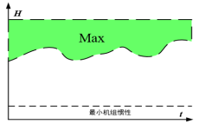
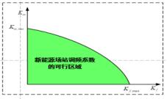
Synchronized frequency and voltage control technology and cluster dispatching and evaluation system
Data model hybrid drive synchronization frequency and voltage control technology for large-scale new energy power generation friendly grid connection (CRRC Zhuzhou Wind Power Division, SDIC Huanghe Company)
Large scale new energy power generation cluster dispatching and evaluation system (Jiangsu Electric Power Company, Zhejiang Electric Power Company, Anhui Electric Power Company, Hebei Electric Power Company, Tianjin Electric Power Company)
Aggregation modeling and cluster scheduling of operation data of new energy stations
Estimation of inertia and frequency support capacity of new energy field energy storage station

Slide 8
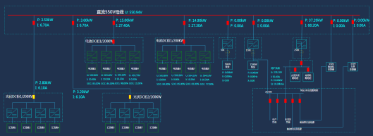
01
Microgrid Cluster
&Virtual Power Plant
02
Integrated Energy System
(PV-ESS-DG-Heating)
03
Zero Carbon Park Project
(PV-ESS-Charging)
04
Microgrid Laboratory
(AC/DC System)
Xinjiang 703 Institute Madong Oilfield PV-ESS-DG Project
Model project awarded by Ministry of Industry and Information Technology
Location&Commissioning
Place: Hetian, Xinjiang Time of putting into operation: September 2022
Installed Capacity
PV system: 446kWp Energy storage system: 400kw/800kWh
Diesel generator: 50kw * 1, 440kW * 1
Advantages an characteristic
Advantages and Characteristics
For the PV-ESS-DG project in the Taklimakan Desert of Xinjiang, AI Power team innovated and adopted the DC flexible scheme of PV-ESS-DG, combined with the smart energy management system developed by AI Power, with an annual power generation of 650000 kWh, 140 tons of standard coal can be saved, and about 370 tons of carbon dioxide can be reduced.

Slide 9
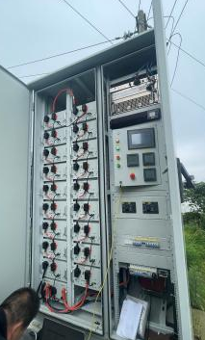
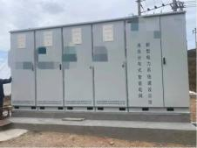
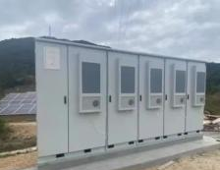
01
Microgrid Cluster
&Virtual Power Plant
02
Integrated Energy System
(PV-ESS-DG-Heating)
03
Zero Carbon Park Project
(PV-ESS-Charging)
04
Microgrid Laboratory
(AC/DC System)
New Island Power System in Dongtou, Zhejiang Province
Location&Commissioning
Place: Wenzhou, Zhejiang Time of putting into operation: October 2022
Installed Capacity
PV system: 40kW Energy storage system: 150kW/1100kWh
Advantages and Characteristics
Advantages and characteristics
The technical team of AI Power has innovatively developed 50kW/100kWh modular products based on local conditions, transportation difficulties, isolated islands in the sea, on-site traffic inconvenience and other factors, which are characterized by good anti-corrosion, fire prevention, waterproof, dust prevention (wind and sand prevention), etc.In the off grid state, it can independently support operation for 7 days.

Slide 10
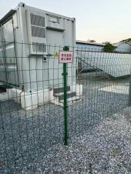
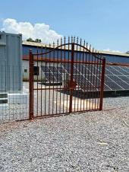
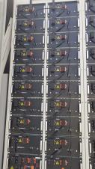
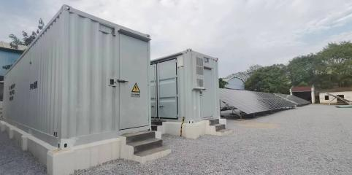
01
Microgrid Cluster
&Virtual Power Plant
02
Integrated Energy System
(PV-ESS-DG-Heating)
03
Zero Carbon Park Project
(PV-ESS-Charging)
04
Microgrid Laboratory
(AC/DC System)
Yunnan Dehong PV-ESS Integrated Energy System
Location&Commissioning
Place: Dehong, Yunnan Time of putting into operation: February 2023
Installed Capacity
PV system:100kWp Energy storage system: 150kW/300kwh
Advantages and Characteristics
The operation of the project, "The Belt and Road Initiative Cross border Urban Application Demonstration Construction Supporting Equipment", has improved the power supply reliability of the overall line at home and abroad, and can guarantee the emergency power supply capacity of border residents and part of overseas people under extreme conditions.

Slide 11
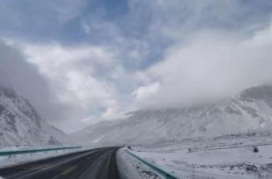
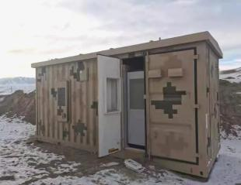
01
Microgrid Cluster
&Virtual Power Plant
02
Integrated Energy System
(PV-ESS-DG-Heating)
03
Zero Carbon Park Project
(PV-ESS-Charging)
04
Microgrid Laboratory
(AC/DC System)
Xinjiang Military Civilian Integration PV-ESS-DG Project
Location&Commissioning
Place: Kashgar, Xinjiang Time of putting into operation: October 2021
Installed Capacity
PV system: 100kW Diesel generator: 30kW * 2, 100kW * 1
Energy storage system: 30kW/60kWh (rare earth battery)
200kW/400kWh (lithium battery)
Advantages and Characteristics
Advantages and characteristics
It is an off grid power supply system for a border post. The project has a harsh operating environment, with an altitude of 4500 meters and a temperature of - 45 ℃.The operation of the project has greatly improved the working and living scenes of our border guards and reduced the pressure on logistics supply.

Slide 12
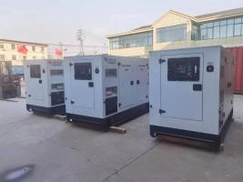
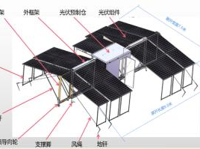
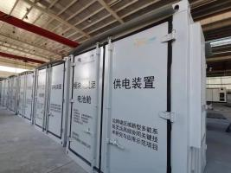
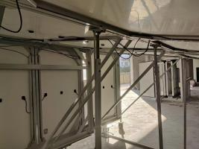
01
Microgrid Cluster
&Virtual Power Plant
02
Integrated Energy System
(PV-ESS-DG-Heating)
03
Zero Carbon Park Project
(PV-ESS-Charging)
04
Microgrid Laboratory
(AC/DC System)
Yunnan Modularization Flexible Power Supply System Project
Location&Commissioning
Place: Yunnan Honghe Time of putting into operation: May 2022
Installed Capacity
PV system: 10kW * 6 Energy storage system: 50kW/100kWh * 6
Diesel generator: 130kW * 3 Transformer: 250kVA * 1
Advantages and Characteristics
PV-ESS-DG and Modularization Flexible Power Supply System,
Independent networking, grid connection, multi module parallel connection, seamless switching of diesel units
With monitoring, protection, multiple charging and discharging modes, black start and other functions.

Slide 13
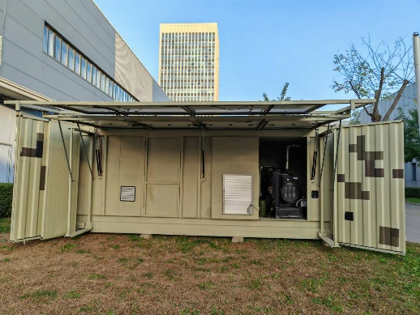
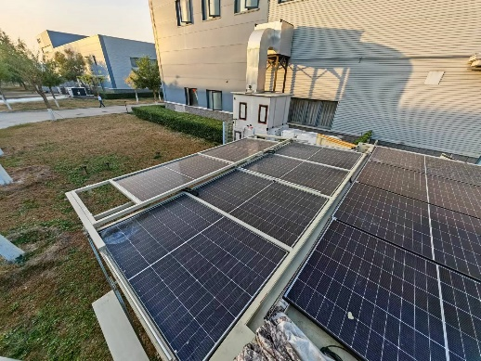
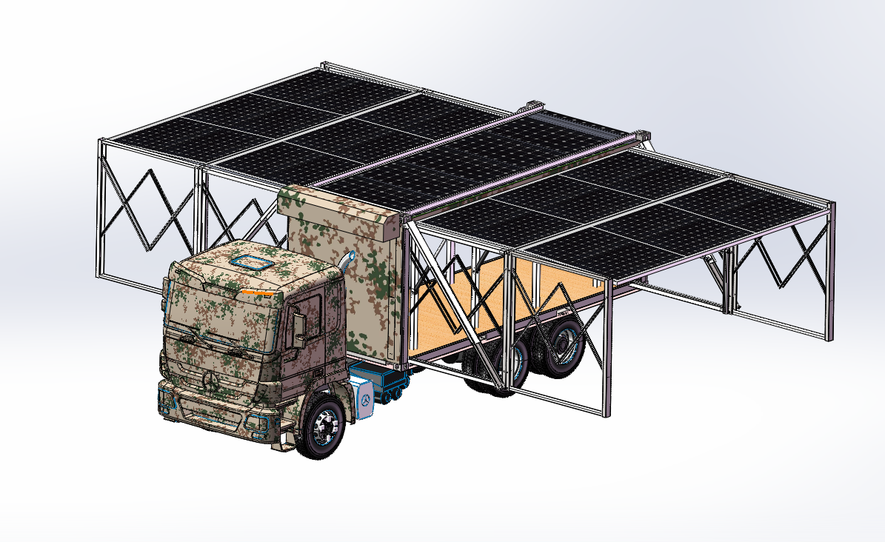
01
Microgrid Cluster
&Virtual Power Plant
02
Integrated Energy System
(PV-ESS-DG-Heating)
03
Zero Carbon Park Project
(PV-ESS-Charging)
04
Microgrid Laboratory
(AC/DC System)
PV-ESS-DG
integrated Container
Location&Commissioning
Place: Tianjin Time of putting into operation: May 2023
Installed Capacity
PV system: 10kW Energy storage system: 50kW/100kWh
Diesel generator: 30kW *1 20’ ESS container
Advantages and Characteristics
The use of grid-type inverters, high-efficiency microgrid management system, integrating multiple modes, flexible strategies, realizing the input, integration and conversion of multiple energy sources, scheduling different energy inputs according to certain rules, and stabilizing the output of voltage and power required by the load.Adopting vehicle-mounted container design, standardized power interface, photovoltaic system design and high-efficiency exhibition and withdrawal structure to meet the relevant specifications while ensuring excellent mobility performance.

Slide 14
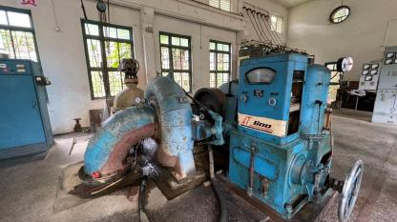
01
Microgrid Cluster
&Virtual Power Plant
02
Integrated Energy System
(PV-ESS-DG-Heating)
03
Zero Carbon Park Project
(PV-ESS-Charging)
04
Microgrid Laboratory
(AC/DC System)
Guangdong Shaoguan Hydropower Project
Location&Commissioning
Place: Shaoguan, Guangdong Time of putting into operation: October 2021
Installed Capacity
Hydropower system: 800kW PV System: 100kW * 1
Energy storage system: 200kW/400kWh (lithium battery)
Advantages and Characteristics
In order to solve the problems of small hydropower consumption in mountainous areas, weak terminal power supply capacity and poor power supply quality, a Water-PV-ESS microgrid system is deployed in Shaoguan Hydropower Station, which can operate independently under fault conditions, and solve the problem of hydropower photovoltaic consumption under off grid conditions, so as to avoid blocking the Water-PV rush channel, and thus improve the reliability and quality of power supply in the region.

Slide 15
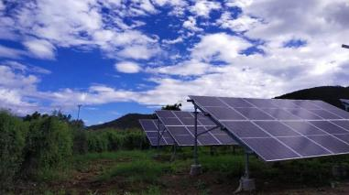
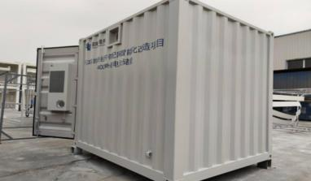
01
Microgrid Cluster
&Virtual Power Plant
02
Integrated Energy System
(PV-ESS-DG-Heating)
03
Zero Carbon Park Project
(PV-ESS-Charging)
04
Microgrid Laboratory
(AC/DC System)
Yunnan Dali New Rural Distributed PV-ESS Project
Location&Commissioning
Place: Dali , Yunnan Time of putting into operation: May 2020
Installed Capacity
PV system: 1MW Energy storage system: 200kW/450kWh
Advantages and characteristics
Advantages and Characteristics
In view of the problems of power supply in mountainous areas of Yunnan Power Grid, weak grid structure, long transmission lines, poor power supply reliability and so on, AI Power has adopted smart technologies such as remote monitoring, cloud platform technology, the latest control logic, remote operation and maintenance, and has realized a powerful exploration of new energy smart grid technology by combining the characteristics of grid requirements and PV-ESS work.

Slide 16
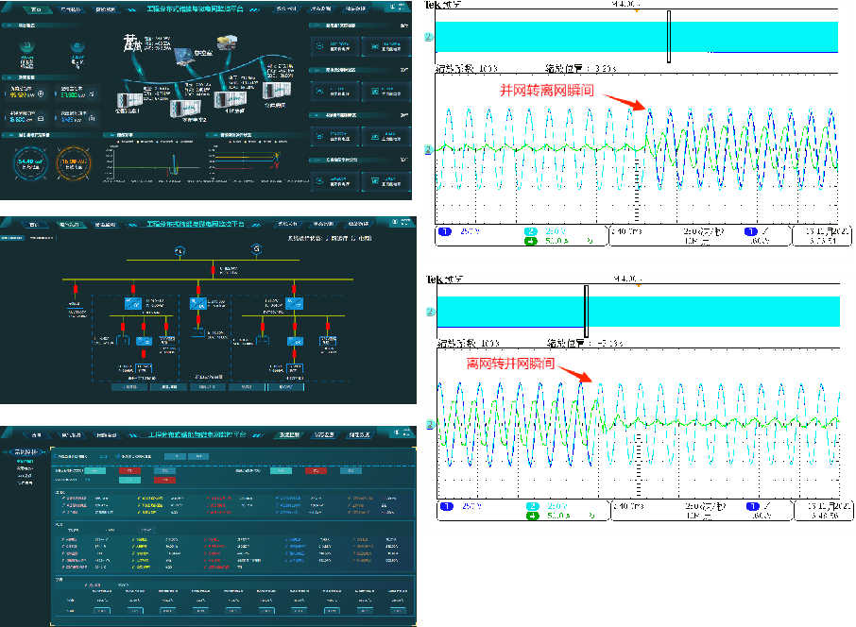
01
Microgrid Cluster
&Virtual Power Plant
02
Integrated Energy System
(PV-ESS-DG-Heating)
03
Zero Carbon Park Project
(PV-ESS-Charging)
04
Microgrid Laboratory
(AC/DC System)
FuJian military Microgrid
Location&Commissioning
Place:Fujian, China Time of putting into operation: Jan. 2024
Installed Capacity
Energy storage system: ≥ 200kWh
Diesel generator power: ≥ 80kW
Advantages and Characteristics
Through MGCC strategy control, VSG mode is used for grid structured inverter to realize friendly cooperation between inverter and diesel generator system and seamless switching capability of parallel and off grid mode, so as to ensure high reliability and active power grid support capability of the Owner under different complex working conditions, and ensure reliable concealment performance of equipment with low noise and low heating performance.

Slide 17
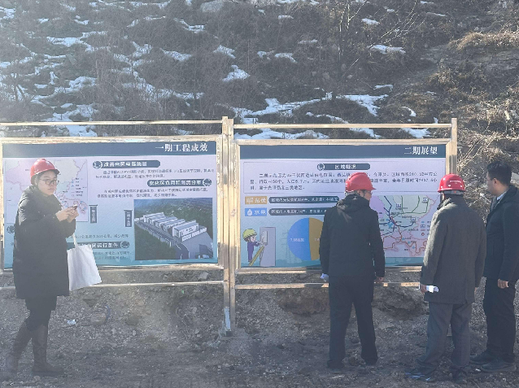
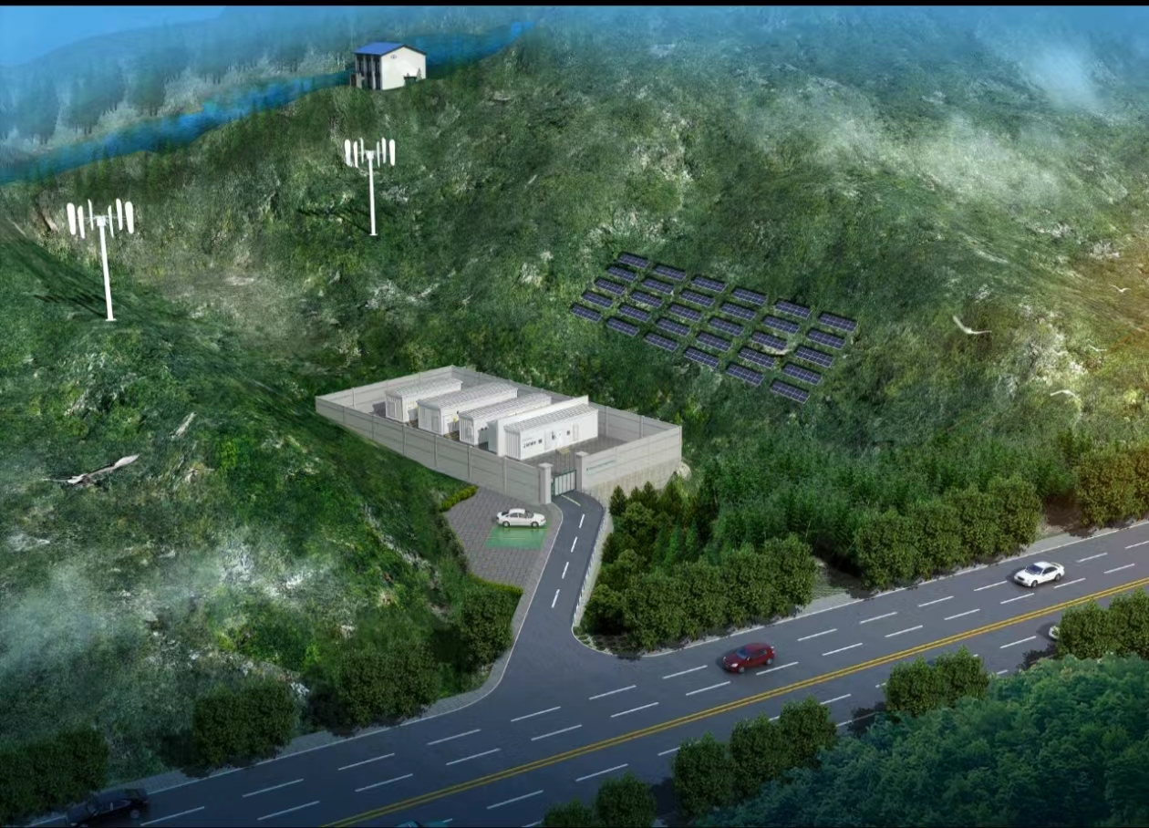
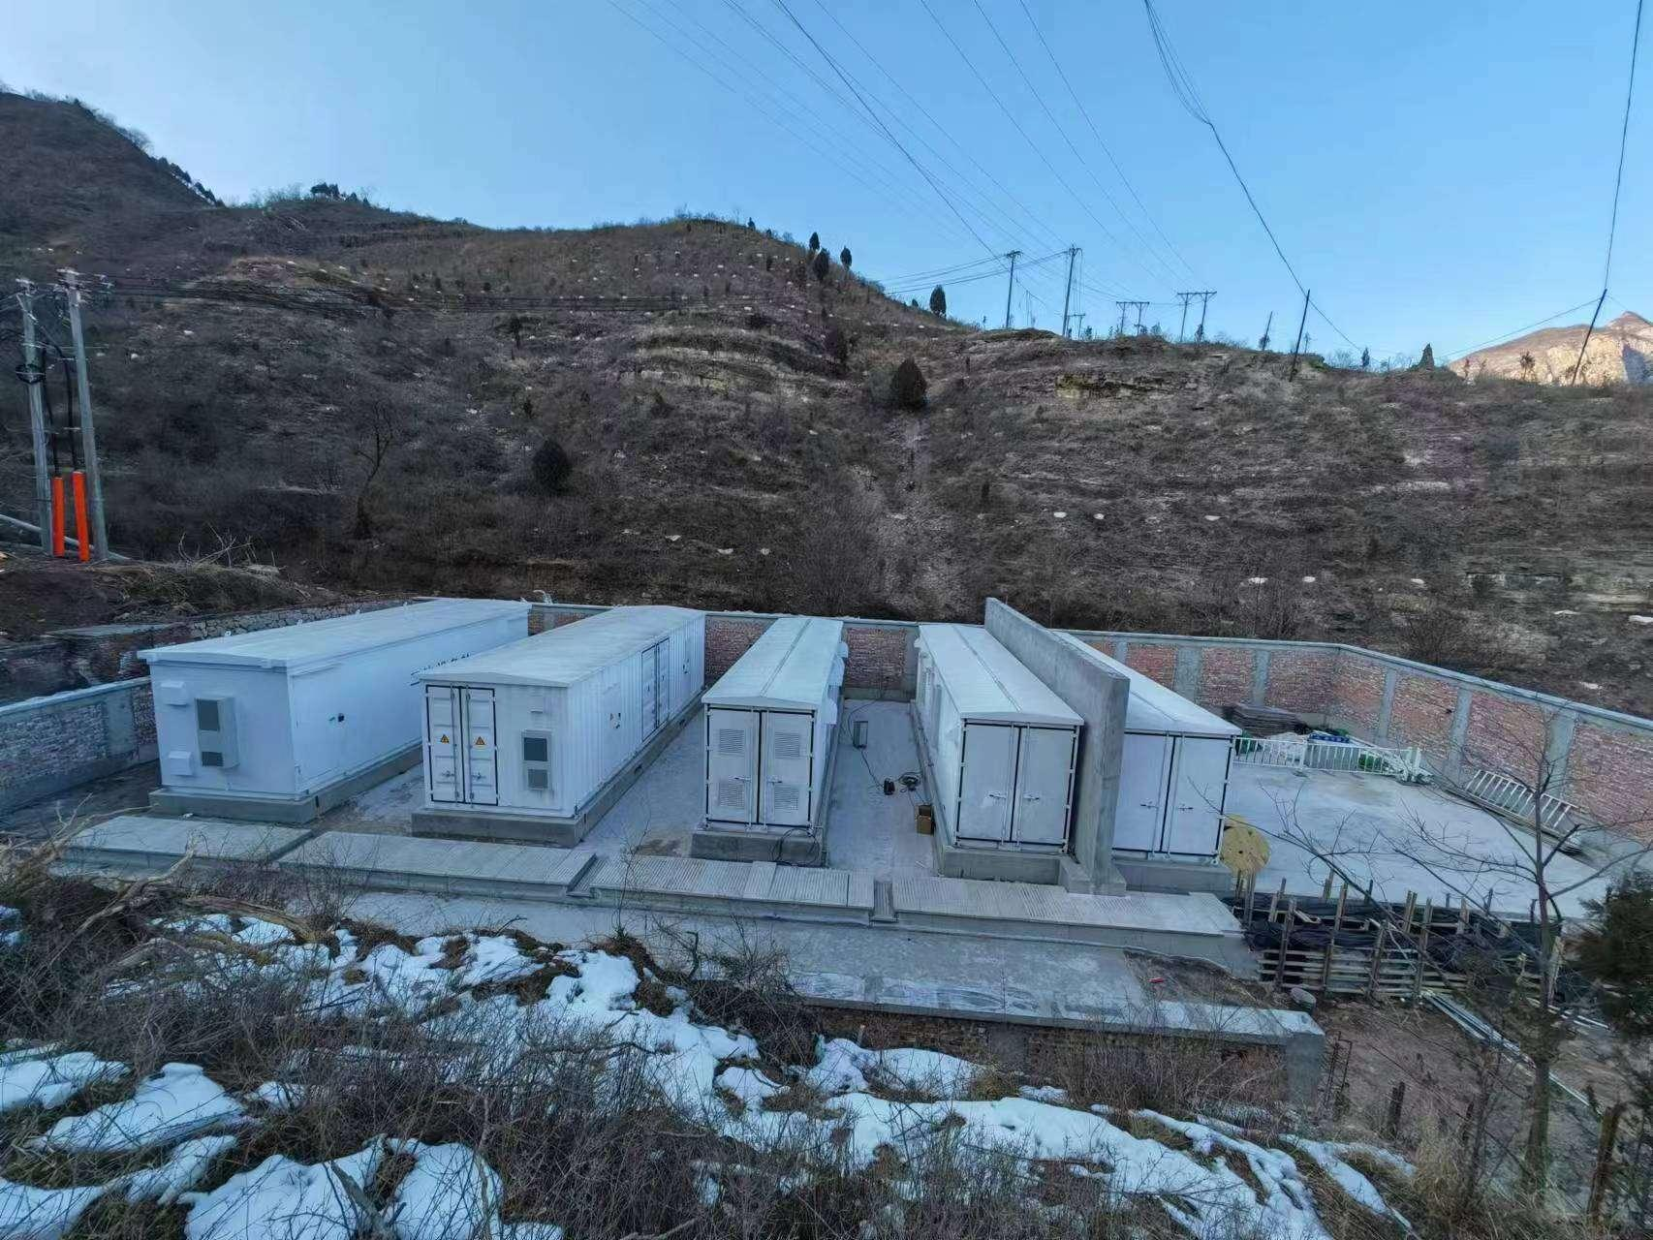
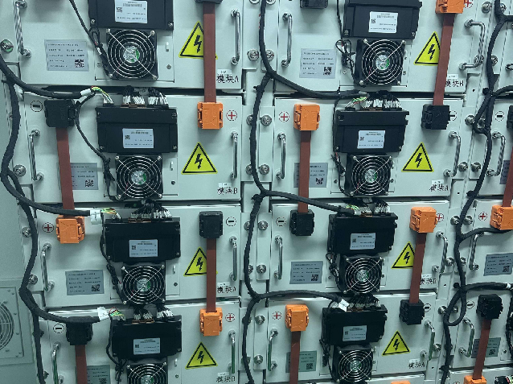
01
Microgrid Cluster
&Virtual Power Plant
02
Integrated Energy System
(PV-ESS-DG-Heating)
03
Zero Carbon Park Project
(PV-ESS-Charging)
04
Microgrid Laboratory
(AC/DC System)
FuJian Tunel Microgrid
Location&Commissioning
Place:Fujian, China Time of putting into operation: Jan. 2024
Installed Capacity
Energy storage system: ≥ 200kWh
Diesel generator power: ≥ 80kW
Advantages and Characteristics
Through MGCC strategy control, VSG mode is used for grid structured inverter to realize friendly cooperation between inverter and diesel generator system and seamless switching capability of parallel and off grid mode, so as to ensure high reliability and active power grid support capability of the Owner under different complex working conditions, and ensure reliable concealment performance of equipment with low noise and low heating performance.

Slide 18
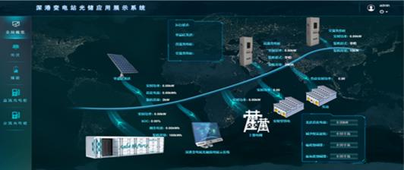
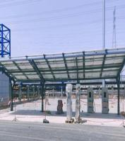
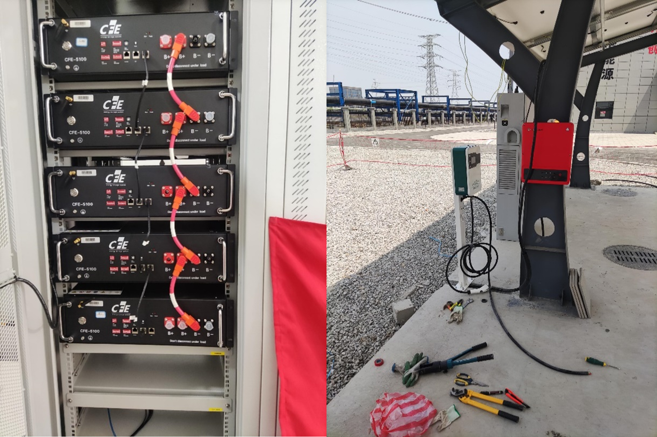
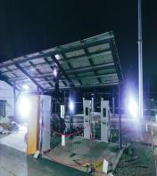
01
Microgrid Cluster
&Virtual Power Plant
02
Integrated Energy System
(PV-ESS-DG-Heating)
03
Zero Carbon Park Project
(PV-ESS-Charging)
04
Microgrid Laboratory
(AC/DC System)
Lianyungang PV-ESS-Charging Smart Park
Location&commissioning
Location&Commissioning
Installed capacity
Place: Dali , Yunnan Time of putting into operation: May 2020
Instaled capacity
Installed Capacity
AC Optical Storage and Charging System,
PV system: 30kW Energy storage system: 10kW/20kWh
Charging Station: AC 7kW * 2, DC 40kW * 1
Advantages and characteristics
Advantages and Characteristics
The first local PV-ESS-Charging integrated energy project with grid connection/disconnection function.
The all green power project is finally composed of smart car shed, PV system, Energy storage system, charging station and micro grid management system, which can meet the requirements of 24-hour operation.

Slide 19
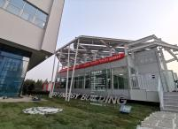
01
Microgrid Cluster
&Virtual Power Plant
02
Integrated Energy System
(PV-ESS-DG-Heating)
03
Zero Carbon Park Project
(PV-ESS-Charging)
04
Microgrid Laboratory
(AC/DC System)
Tianjin Zero carbon Cabin
Location&cmmissioning
Location&Commissioning
Place: Tianjin Time of putting into operation: May 2020
Installed Capacity
Total generating capacity: 20.7kWp Energy storage system: 40kWh
Advantages and characteristics
Advantages and Characteristics
Advantages and characteristics
AI Power team creatively applied green low-carbon energy-saving technology and integrated smart energy management and control technology to ensure that the DC microgrid in the building provides continuous, stable, high-quality and efficient power, and achieve the goal of zero energy consumption in the building;The system integrates power generation,smart luminous induction and other functions to realize the organic combination of people, roads and green energy.

Slide 20
01
Microgrid Cluster
&Virtual Power Plant
02
Integrated Energy System
(PV-ESS-DG-Heating)
03
Zero Carbon Park Project
(PV-ESS-Charging)
04
Microgrid Laboratory
(AC/DC System)
Zhenjiang PV-ESS-Charging Smart Park Project (Grid connected)
Location&Commissioning
Place: Zhenjiang, Jiangsu Time of putting into operation: October 2021
Installed Capacity
PV system: 50kW×2 Energy storage system: 50kW/25kWh×2
Charging station: 30kW (DCDC)×8 AC/DC converter: 250kW × 2
Advantages and characteristics
Advantages and Characteristics
Through the low-voltage flexible and direct interconnection system, the project can realize multiple operation modes of two stations, including off grid interconnection and discrete operation between DC systems, and also realize interconnected operation between stations, with controllable power flow and mutual aid of power.It effectively solved the problems of mismatch between heavy and light load in the platform area, difficulty in capacity expansion in the platform area, and difficulty in new energy consumption.

Slide 21
01
Microgrid Cluster
&Virtual Power Plant
02
Integrated Energy System
(PV-ESS-DG-Heating)
03
Zero Carbon Park Project
(PV-ESS-Charging)
04
Microgrid Laboratory
(AC/DC System)
Inner Mongolia PV-ESS-Charging Smart Park
Location&Commissioning
Place: Hohhot, Inner Mongolia Time of putting into operation: October 2019
Installed Capacity
PV system: 250kW Wind power system: 4kW * 1
Energy storage system: 200kW/400kWh (lithium battery)
Teaching and training system*1
Advantages and characteristics
Advantages and Characteristics
The purpose of this project is to further expand the training content and training methods of Inner Mongolia Power Group Power Training School in the field of smart micro grid, improve the basic knowledge, technical theory and operating skills of relevant trainers in relevant fields, and provide a platform for talent cultivation of the group company through the implementation of this scientific research project.

Slide 22
01
Microgrid Cluster
&Virtual Power Plant
02
Integrated Energy System
(PV-ESS-DG-Heating)
03
Zero Carbon Park Project
(PV-ESS-Charging)
04
Microgrid Laboratory
(AC/DC System)
Guangdong Foshan PV-ESS-Charging
Low Carbon Park
Location&Commissioning
Installed capacity
Place: Foshan, Guangdong Time of putting into operation: April 2021
Installed Capacity
PV system: 20kW Energy storage system: 500kW/1.1MWh
Charging station: 120kW * 2
Advantages and characteristics
Advantages and Characteristics
The project is a 10kV village level micro grid, which has the functions of photovoltaic full data scene monitoring, energy storage full field monitoring, PV-ESS remote adjustment and remote control, and can reasonably allocate loads, effectively save power, and achieve optimal operation.

Slide 23
01
Microgrid Cluster
&Virtual Power Plant
02
Integrated Energy System
(PV-ESS-DG-Heating)
03
Zero Carbon Park Project
(PV-ESS-Charging)
04
Microgrid Laboratory
(AC/DC System)
CRRC Smart Valley Zero Carbon Park Project
Location&Commissioning
Installed capacity
Place: Zhuzhou, Hunan Time of putting into operation: June 2021
Installed Capacity
PV system: 300kW Charging station: AC 7kW * 4 DC 30kW * 2
Energy storage system: 50kW/90kWh (lithium titanate)
200kW/400kWh (lithium iron phosphate)
Advantages and characteristics
Advantages and Characteristics
The project is a comprehensive energy system of the park invested and constructed by CGN, which is required to achieve the most economical operation.The system uses photovoltaic, energy storage, ground source heat pump, and airborne air conditioning to provide comprehensive energy supply for the park, and achieve integrated monitoring and energy management of photovoltaic, energy storage, and energy stations.

Slide 24
01
Microgrid Cluster
&Virtual Power Plant
02
Integrated Energy System
(PV-ESS-DG-Heating)
03
Zero Carbon Park Project
(PV-ESS-Charging)
04
Microgrid Laboratory
(AC/DC System)
Nanjing WIND-PV-ESS Smart Park Project
Location&Commissioning
Place: Nanjing, Jiangsu Time of putting into operation: July 2021
Installed Capacity
PV system: monocrystalline silicon * 20kW, polycrystalline silicon * 20kW, film module * 10kW
Wind turbine: horizontal axis * 2 vertical axis * 2
Energy storage system: 50kW/100kWh
Advantages and characteristics
Advantages and Characteristics
The integrated energy management platform independently developed by AI Power has successfully and efficiently realized the multi energy complementary application scenario. In addition to the original background data system, a simple and beautiful large screen display system has been added to meet the needs of actual visit and display.

Slide 25
01
Microgrid Cluster
&Virtual Power Plant
02
Integrated Energy System
(PV-ESS-DG-Heating)
03
Zero Carbon Park Project
(PV-ESS-Charging)
04
Microgrid Laboratory
(AC/DC System)
Northeast Electric Power University
Low Carbon Park Project
Location&Commissioning
Installed capacity
Place: Jilin, Jilin Time of putting into operation: May 2023
Installed Capacity
Car shed PV system: 20kW Energy storage system: 50kW/100kWh
Charge station: DC 60kW * 1, AC 7KW * 1
Advantages and characteristics
Advantages and characteristics
Advantages and Characteristics
The PV-ESS-Charging system fully considers the conditions of large temperature difference in the fourth level in the northeast and high cold in winter, providing a model for the deployment of PV-ESS-Charging system in extremely cold areas.

Slide 26
01
Microgrid Cluster
&Virtual Power Plant
02
Integrated Energy System
(PV-ESS-DG-Heating)
03
Zero Carbon Park Project
(PV-ESS-Charging)
04
Microgrid Laboratory
(AC/DC System)
V2G demonstration station
control management platform project
Location&Commissioning
Installed capacity
Place:Shanghai, China Time of putting into operation: Feb. 2024
Installed Capacity
Car shed PV system: 170kW Energy storage system:100kW/200kWh
V2G Charge station: 10kW * 5
Advantages and characteristics
Advantages and characteristics
Advantages and Characteristics
Add anti-islanding device to ensure the safety of electricity consumption.New EMS, comprehensive access to equipment data, charging and discharging management for V2G charging piles, and unified strategy management for photovoltaic, energy storage and charging piles, forming a complete optical storage and charging microgrid, with data access to the cloud, and a clear and complete display of information to facilitate remote management.

Slide 27
01
Microgrid Cluster
&Virtual Power Plant
02
Integrated Energy System
(PV-ESS-DG-Heating)
03
Zero Carbon Park Project
(PV-ESS-Charging)
04
Microgrid Laboratory
(AC/DC System)
Henan digital twin microgrid project
Location&Commissioning
Installed capacity
Place: Henan Xinde Industry Park, China Time of putting into operation: Nov. 2023
Installed Capacity
PV system:4.2MW Wind power system:2MW
Energy storage system: 1MW*4h
Advantages and characteristics
Advantages and characteristics
Advantages and Characteristics
Realize real-time monitoring, situational awareness and optimization decision-making of the full amount of distributed power supply, energy storage, adjustable loads and power grids, and enhance the level of regional autonomy of microgrids and the intelligence of friendly coordination and interaction with the upper-level power grids.

Slide 28
01
Microgrid Cluster
&Virtual Power Plant
02
Integrated Energy System
(PV-ESS-DG-Heating)
03
Zero Carbon Park Project
(PV-ESS-Charging)
04
Microgrid Laboratory
(AC/DC System)
Shanghai Electric Power University Microgrid Laboratory
Installed capacity
Location&Commissioning
Place: Shanghai Time of putting into operation: May 2022
Installed Capacity
A complete set of Wind, PV, ESS AC microgrid system
distributed grid and microgrid distribution system
Advantages and characteristics
Advantages and characteristics
Advantages and Characteristics
The whole experimental system can form a distribution network system with distributed power grid and microgrid, as well as a typical Wind-PV-ESS AC/DC microgrid system, which can realistically simulate the Wind-PV-ESS AC/DC scene, providing a good foundation for students to do various related experiments and scientific research projects.

Slide 29
01
Microgrid Cluster
&Virtual Power Plant
02
Integrated Energy System
(PV-ESS-DG-Heating)
03
Zero Carbon Park Project
(PV-ESS-Charging)
04
Microgrid Laboratory
(AC/DC System)
Hunan CRRC AC/DC Microgrid Laboratory
Location&Commissioning
Place: Zhuzhou, Hunan Time of putting into operation: June 2023
Installed Capacity
DC PV-ESS-Charging system * 3 Single Set: PV system : 50kW Energy storage system: 25kW/50kWh charging station: 30kW
AC PV-ESS-Charging system * 3 Single Set: PV system: 50kW Energy storage system: 25kW/50kWh charging station: 7kW
Advantages and characteristics
Advantages and Characteristics
It can realize the micro grid real-time monitoring, historical data storage and query, real-time control strategy and energy management functions, realize the energy management of large optical storage stations, and carry out simulation experiments such as photovoltaic power generation prediction, AVC response in the station, AGC and primary frequency modulation response.

Slide 30
01
Microgrid Cluster
&Virtual Power Plant
02
Integrated Energy System
(PV-ESS-DG-Heating)
03
Zero Carbon Park Project
(PV-ESS-Charging)
04
Microgrid Laboratory
(AC/DC System)
Hubei Electric Power Academy Microgrid Laboratory
Location&Commissioning
Installed capacity
Place: Wuhan, Hubei Time of putting into operation: April 2022
Installed Capacity
PV system DC source: 500kW Charging station detection platform: 180kW×3 PV system AC source: 500kW RLC load: 500kW
Advantages and characteristics
Advantages and characteristics
Advantages and Characteristics
A set of high-level research and development platform and testing platform for high-power energy storage converter have been established for Hubei Electric Power Research Institute.Build a multi-functional energy storage converter R&D and testing platform with advanced grid topology, flexible control and operation, and integrated system research, standard formulation, equipment testing, and system functional verification.

Slide 31
01
Microgrid Cluster
&Virtual Power Plant
02
Integrated Energy System
(PV-ESS-DG-Heating)
03
Zero Carbon Park Project
(PV-ESS-Charging)
04
Microgrid Laboratory
(AC/DC System)
National University of Defense Technology Micronet Laboratory
Location&Commissioning
Installed capacity
Place: Changsha, Hunan Time of putting into operation: March 2022
Installed Capacity
A complete set of monitoring system for multi microgrid cluster interconnection control experimental platform
Advantages and characteristics
Advantages and Characteristics
The project builds a micro grid cluster control physics experiment platform based on hardware equipment to facilitate the access of various new energy systems and the interconnection operation control between multiple micro grid clusters, which can support the internship, experiment and scientific research work of the relevant undergraduate and graduate students in electrical disciplines.

Slide 32
01
Microgrid Cluster
&Virtual Power Plant
02
Integrated Energy System
(PV-ESS-DG-Heating)
03
Zero Carbon Park Project
(PV-ESS-Charging)
04
Microgrid Laboratory
(AC/DC System)
North China Electric Power University Microgrid Laboratory
Location&Commissioning
Installed capacity
Place: Beijing Time of putting into operation: March 2022
Installed Capacity
Comprehensive laboratory for AC distribution network simulation, DC distribution network simulation, AC/DC hybrid microgrid, efficient utilization of cooling, heating and power, and smart home system.
Advantages and characteristics
Advantages and Characteristics
Through comprehensive energy system planning, operation, control, management, communication and other teaching, experiment, practice and research, it can provide on-site practical services for multi professional college students in electrical, control, automation, renewable, economic management, etc

Slide 33
Foreign project
Foreign project
01
Standard Product Sales
02
Integrated Energy System
(PV-ESS-DG-Heating)
03
Zero Carbon Park Project
(PV-ESS-Charging)

Slide 34
Europe Netherlands Standard Energy Storage Cabinet
01
02
03
Standard Product
Sales
Integrated Energy System
(PV-ESS-DG-Heating)
Zero Carbon Park Project
(PV-ESS-Charging)
Location&Commissioning
Place:Netherlands Time of putting into operation:Dec. 2023
Demand: 50kW/100kWh integrated energy storage cabinets* 10pcs
Installed Capacity
Customized EMS and I-cloud platform
Energy storage system: ≥ 1000kWh
Advantages and Characteristics
AI POWER’s 50kW/100kWh energy storage integrated cabinet. Each cabinet has functions on grid connection and off grid independently. Through the built-in MGCC strategy control, it can realize the grid connection and off grid operation of multiple parallel machines. Not only the local display and control screen, the cabinet can also be remotely monitored and controlled through the i-cloud.

Slide 35
01
02
03
Standard Product
Sales
Integrated Energy System
(PV-ESS-DG-Heating)
Zero Carbon Park Project
(PV-ESS-Charging)
Maldives WIND-PV-DG-ESS Smart Microgird Project
(Global Off Grid Benchmarking Project)
Location&Commissioning
Installed capacity
Place: Maldives Time of putting into operation: July 2019
Installed Capacity
Distributed PV system Average: 300kw
Energy Storage System: 400kW×3h
Advantages and Characteristics
Planning and design of off grid PV-DG-ESS smart grid system, core micro grid energy management system and energy storage equipment, and system integration commissioning.The benchmark demonstration project of global island microgrid was the largest microgrid group in the world.

Slide 36
01
02
03
Standard Product
Sales
Integrated Energy System
(PV-ESS-DG-Heating)
Zero Carbon Park Project
(PV-ESS-Charging)
Angola National Data Center Smart Grid Project
Location&Commissioning
Place: Angra Time of putting into operation: June 2020
Installed Capacity
PV System: 100kW Energy storage system: 150kW/300kWh
Diesel generator: 100kW
Advantages and Characteristics
AI Power provides a complete set of smart grid EMS solutions with TEM-MG smart grid energy management software as the core, which realizes the high requirements of the National Data Center for power supply reliability and can not be cut off.At the same time, we hope to reduce the consumption of diesel as much as possible to reduce the cost of power consumption in the center.

Slide 37
01
02
03
Standard Product
Sales
Integrated Energy System
(PV-ESS-DG-Heating)
Zero Carbon Park Project
(PV-ESS-Charging)
Sendai Japan PV-ESS-DG Off Grid Smart Microgrid Project
Location&Commissioning
Place: Sendai, Japan Time of putting into operation: April 2021
Installed Capacity
PV system: 100kW Energy storage system: 150kW/450kWh
Diesel generator: 100kW
Advantages and Characteristics
The project is an off grid PV-DG-ESS smart microgrid system, located in an industrial park in Sendai, Japan.The expert team of AI Power provided a complete set of smart microgrid EMS solutions to help users achieve the operation goals of seamless switching on and off of diesel units and maximizing the use of renewable energy, which was recognized by Japanese users.

Slide 38
China-Laos Border Interconnection PV-ESS-Charging Mricogrid
01
02
03
Standard Product
Sales
Integrated Energy System
(PV-ESS-DG-Heating)
Zero Carbon Park Project
(PV-ESS-Charging)
Location&Commissioning
Place:Laos Time of putting into operation:Aug.2023
Demand: do a demonstrative PV-ESS-Charging in Laos
Installed Capacity
DC charging: 60kW * 2 AC charging: 7kW * 2
Car shed photovoltaic: 15kW energy storage system: 100kWh
Advantages and Characteristics
The all-green electricity project ultimately consists of intelligent carport, photovoltaic system, energy storage system, charging piles and microgrid management system, to meet the 24-hour operation time,it is the Lao National Electricity Administration to hold this national demonstration project, it has long significance in Laos new erergy industry development.

Slide 39
Thank You

